Slide 1
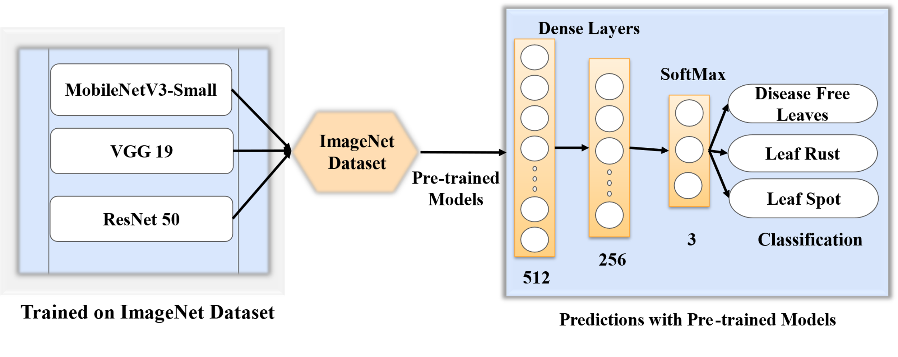
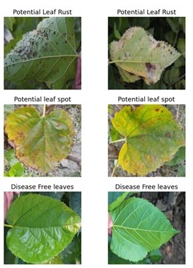
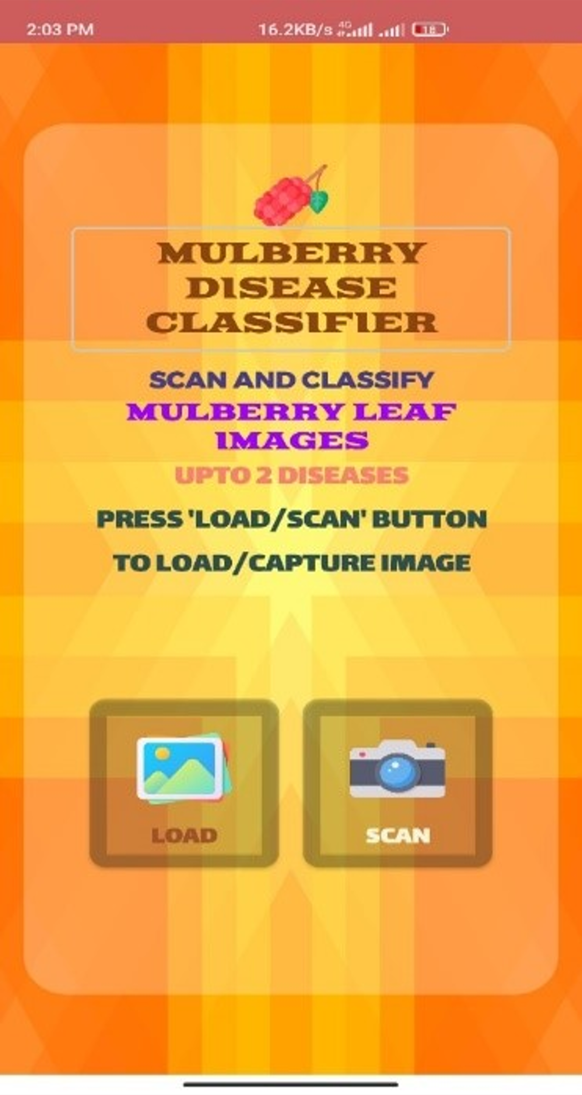
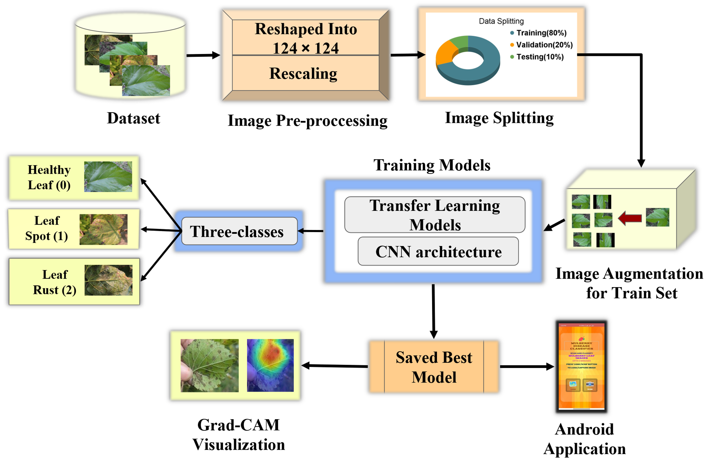
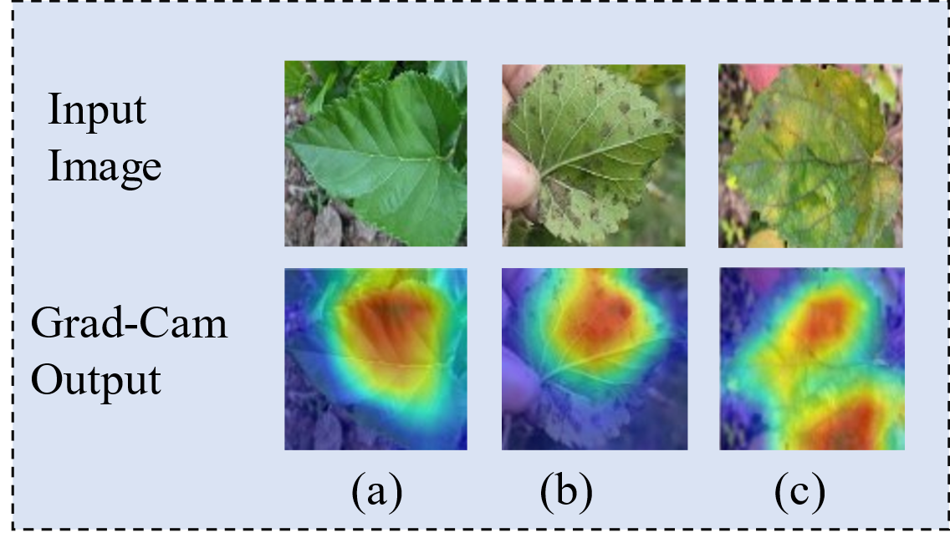
 | Mulberry Leaf Disease Detection. Modified MobileNetV3Small. Interpretability using Grad-CAM Visualization. AI-enabled Mobile Application.
Sample Images
Android Application
Proposed Methodology

